Slide 1
UDS Displaced Voices
Using Data Science Tools for Housing Justice

Slide 2

Project Objectives
Primary Goal: Forecast eviction numbers for 2025 to enable proactive budgeting
Target: Assist Arizona government in allocating rental assistance funds efficiently
Approach: Three-pronged analysis using 2022-2024 eviction data
Impact: Ensure no household is left behind due to funding shortfalls
Find other photo options

Slide 3
Track Members
Visualization Track
Members: Nhi Nguyen, Devang Singhal
Statistical analysis Track
Members: Sean Skinner, Leticia Favero Lopes
Predictive Modeling Track
Members: Sai Roy, Harshini Balamurugan Vadivazhagi,
Rati Tabatadze, Poojitha Nuthalapati, Tylor Vongsenekeo

Slide 4
How each track helps with the project
1
2
3
Visualization Analysis - Exploratory data insights through visual patterns
Statistical Analysis - Identifying key drivers of eviction risk
Predictive Modeling - Time series forecasting for 2025

Slide 5
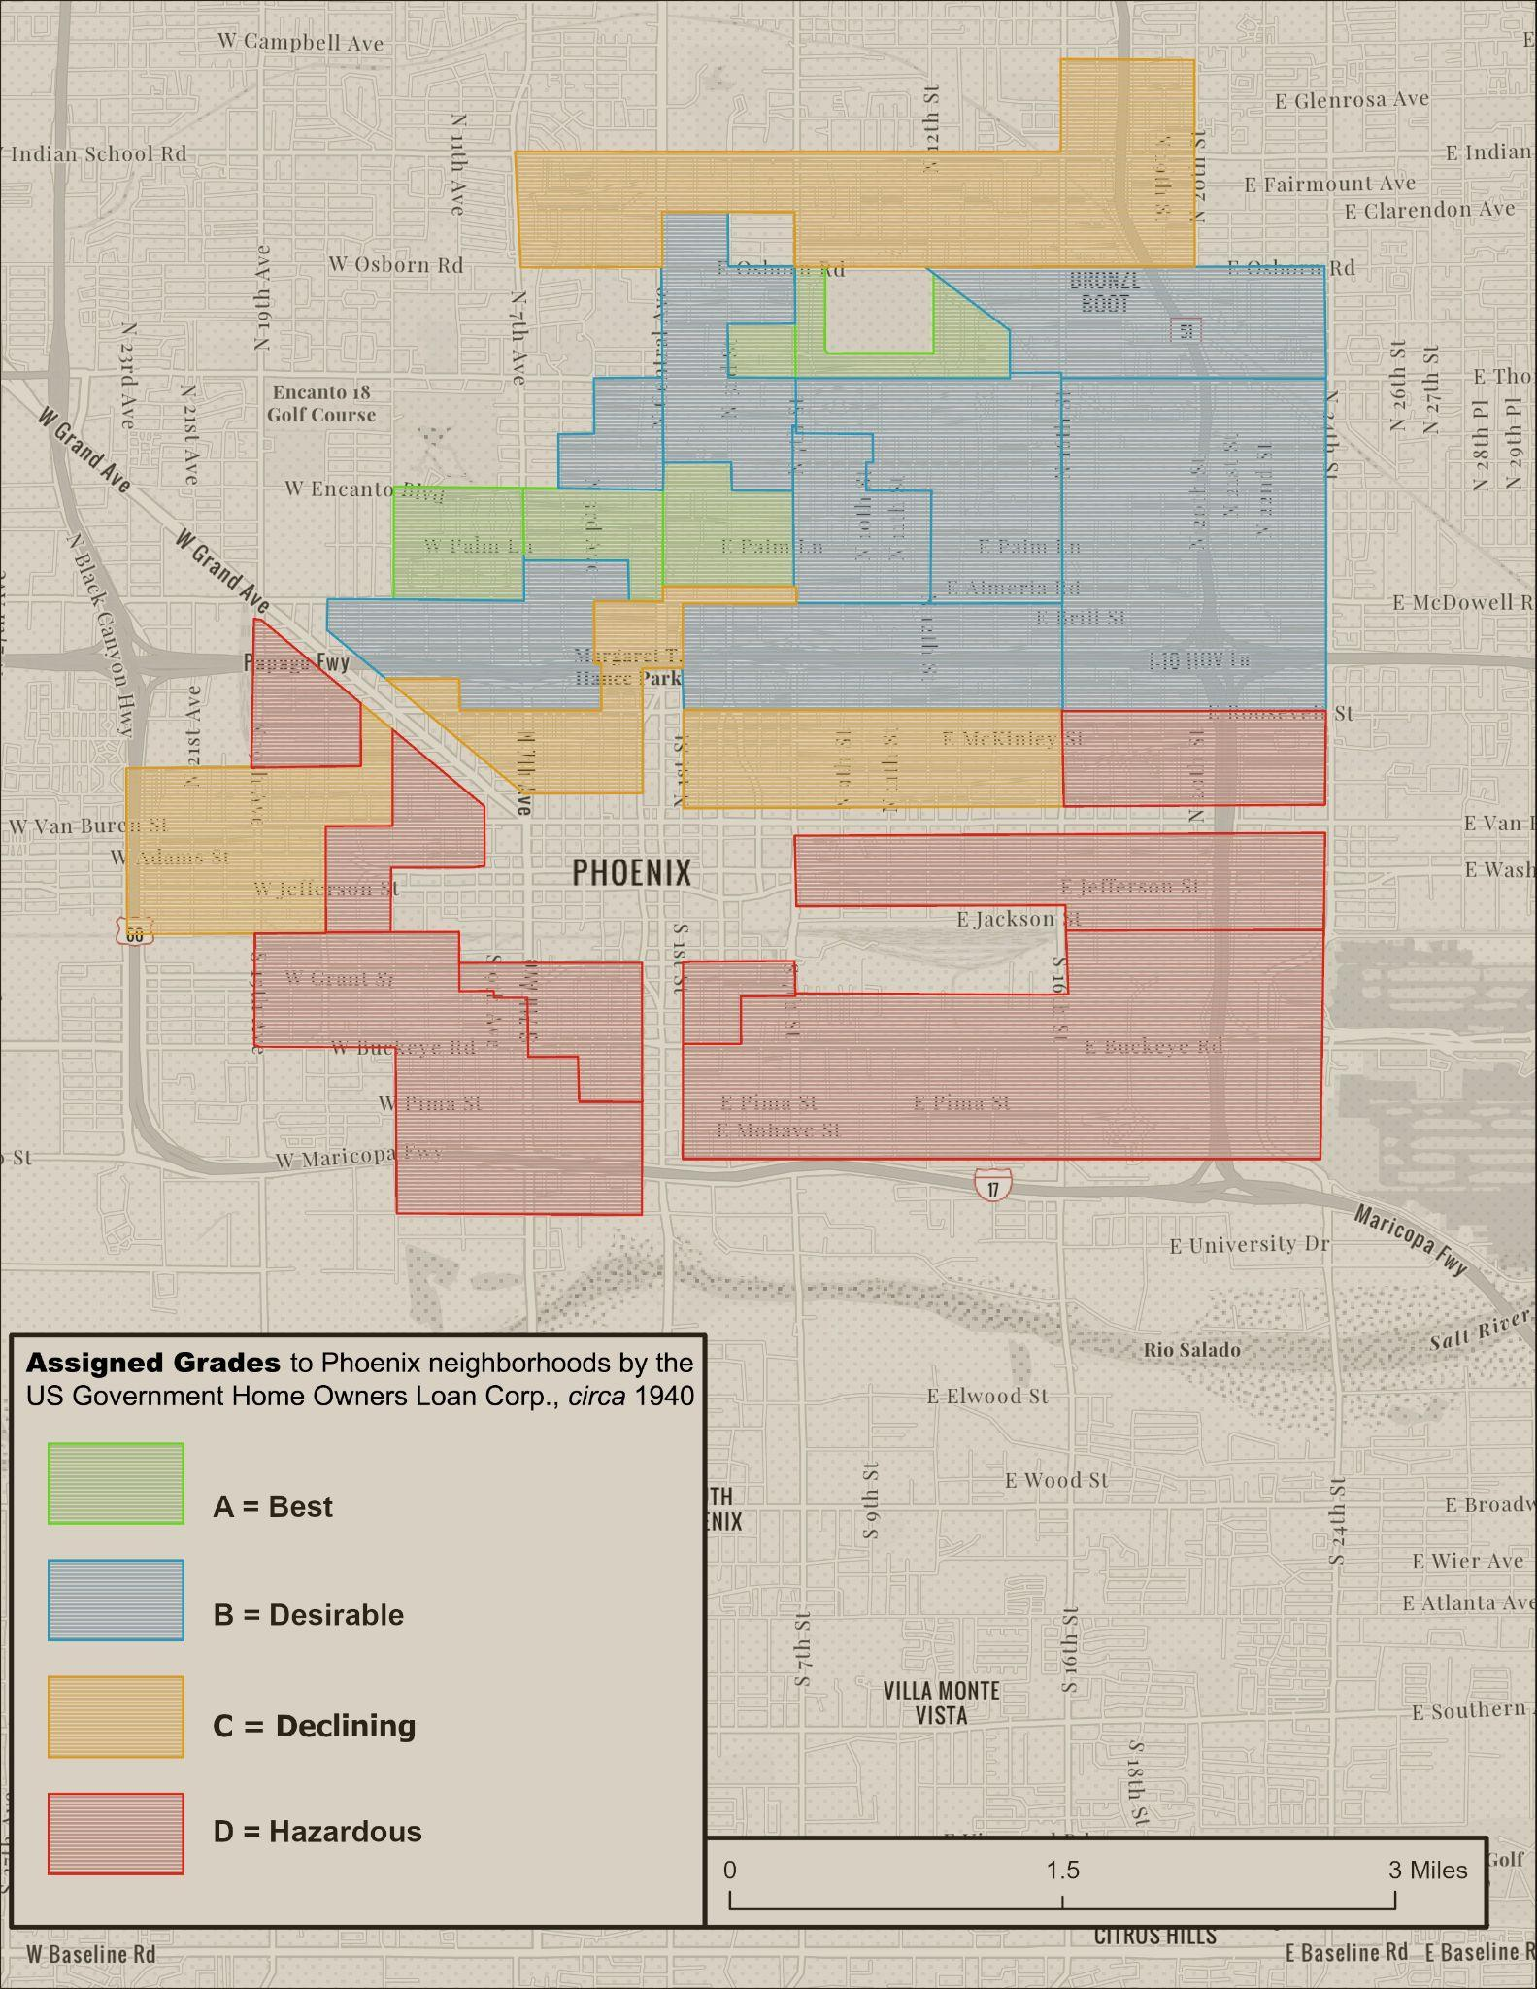
Historical Context(redlining)
In 1932 the Home Owners’ Loan Corporation was created to buy foreclosed properties and delinquent mortgages, to then refinance them under people who could pay them- extending the life of housing loans. In 1935 the HOLC developed “security maps” that show the riskiness of neighborhoods for lending purposes. The Federal Housing Administration would use this map to determine where loans are granted.
Created by ASU’s Knowledge Exchange for Resilience (KER)
Notes:
These maps ensured that almost no loans went to areas that included people of color mainly black residents that favored investment into suburban housing over urban.
Note that this map was created by ASU’s knowledge exchange for resilience with the historical map transposed onto modern day phoenix.
The only redlining map created for Arizona was for downtown phoenix, however redlining is a legacy of discriminatory housing policies affecting the modern housing crisis.
Creating segregated development patterns, encouraging white families to move to newly built suburbs like scottsdale, tempe which already had racially restrictive housing practices excluding minorities.

Slide 6
Visualization track
Nhi Nguyen, Devang Singhal

Slide 7
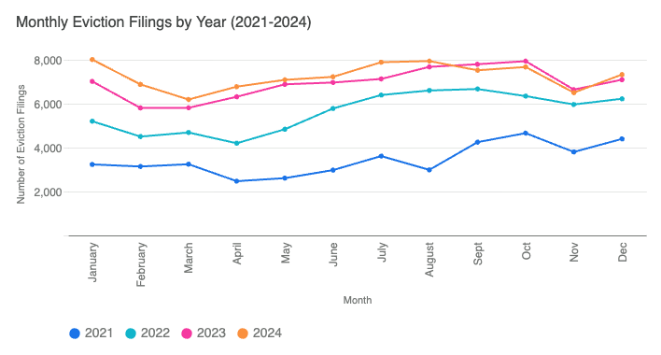
Eviction Filings (2021 - 2024)
Find other photo options

Slide 8
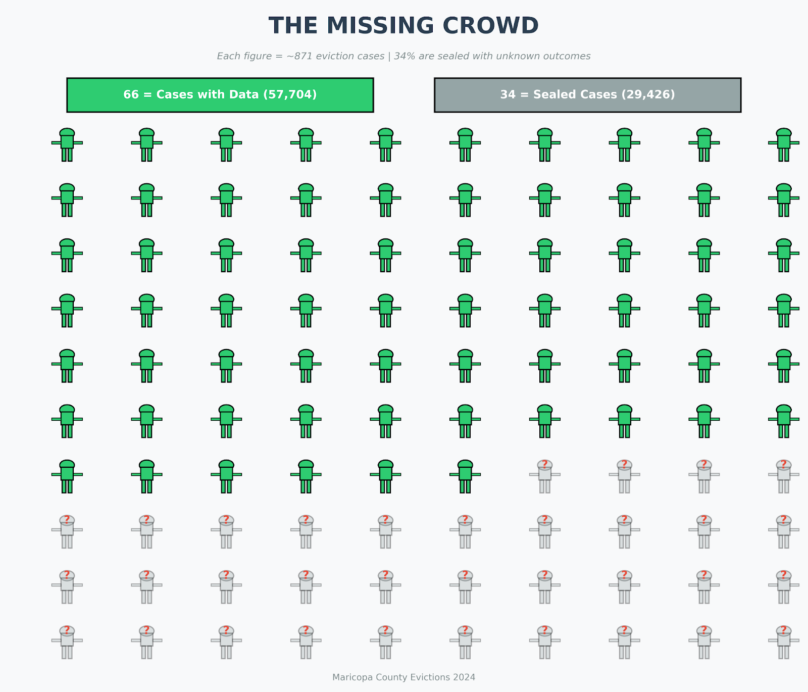
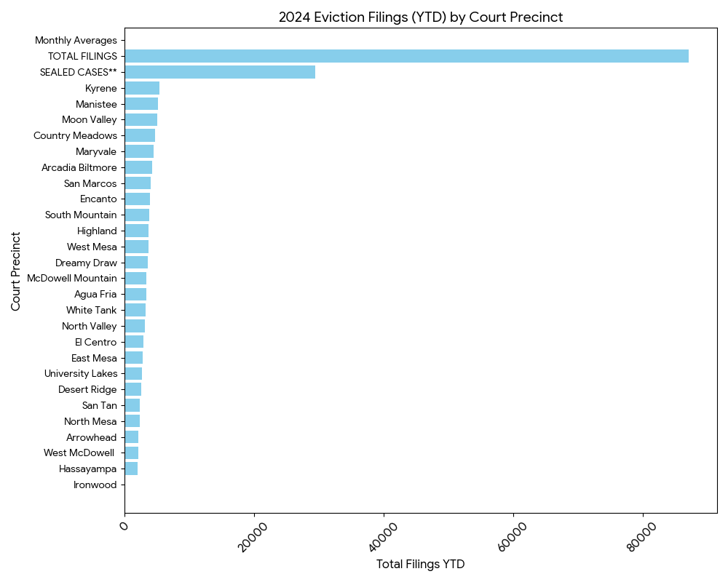
The Cases With Data and Sealed Cases
Find other photo options

Slide 9
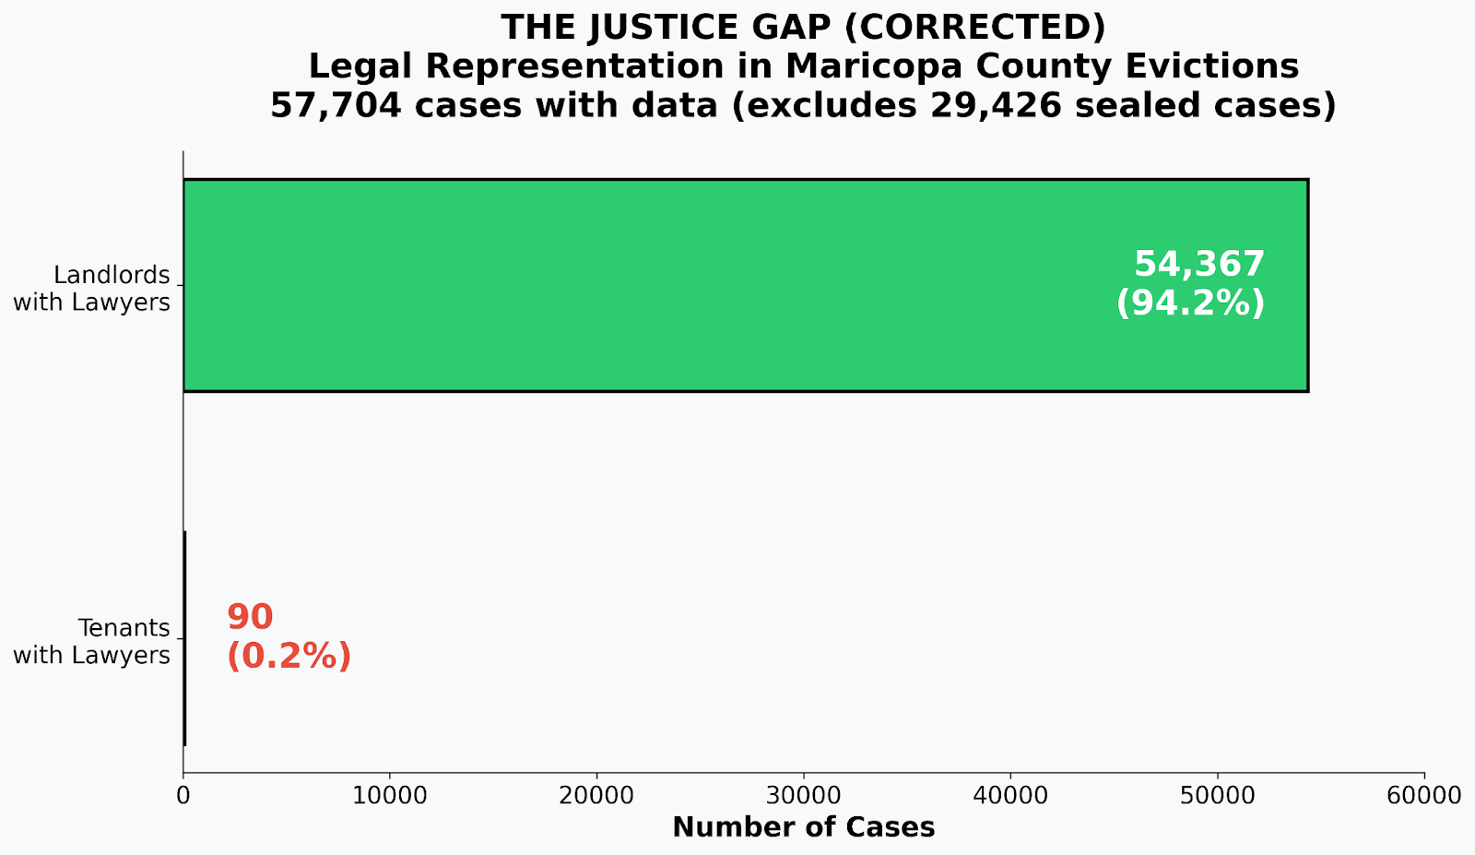
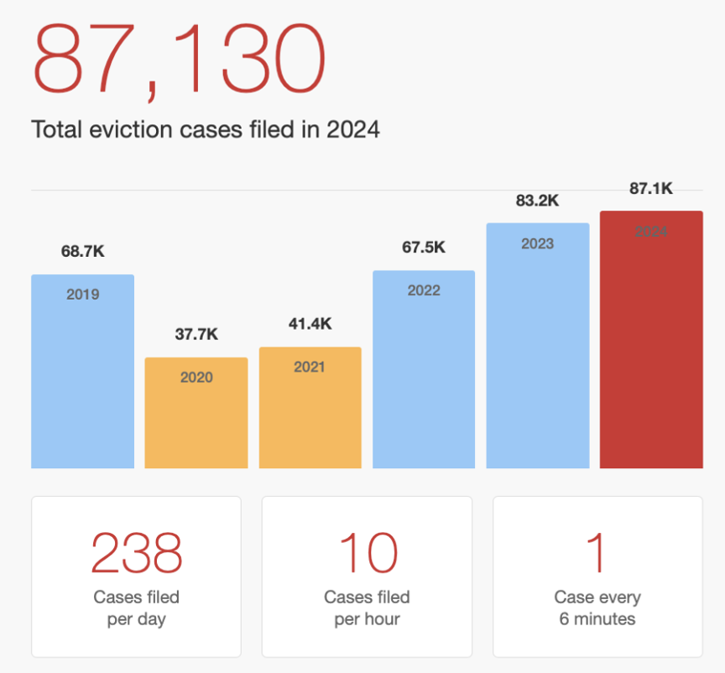
Courts process: Legal representation and Cases filed
Find other photo options

Slide 10
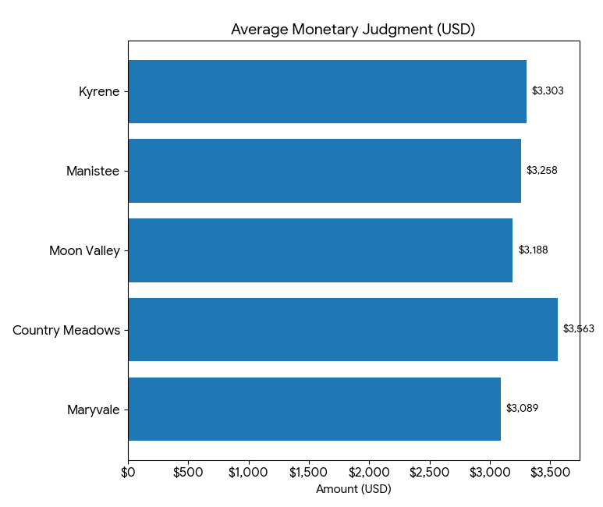
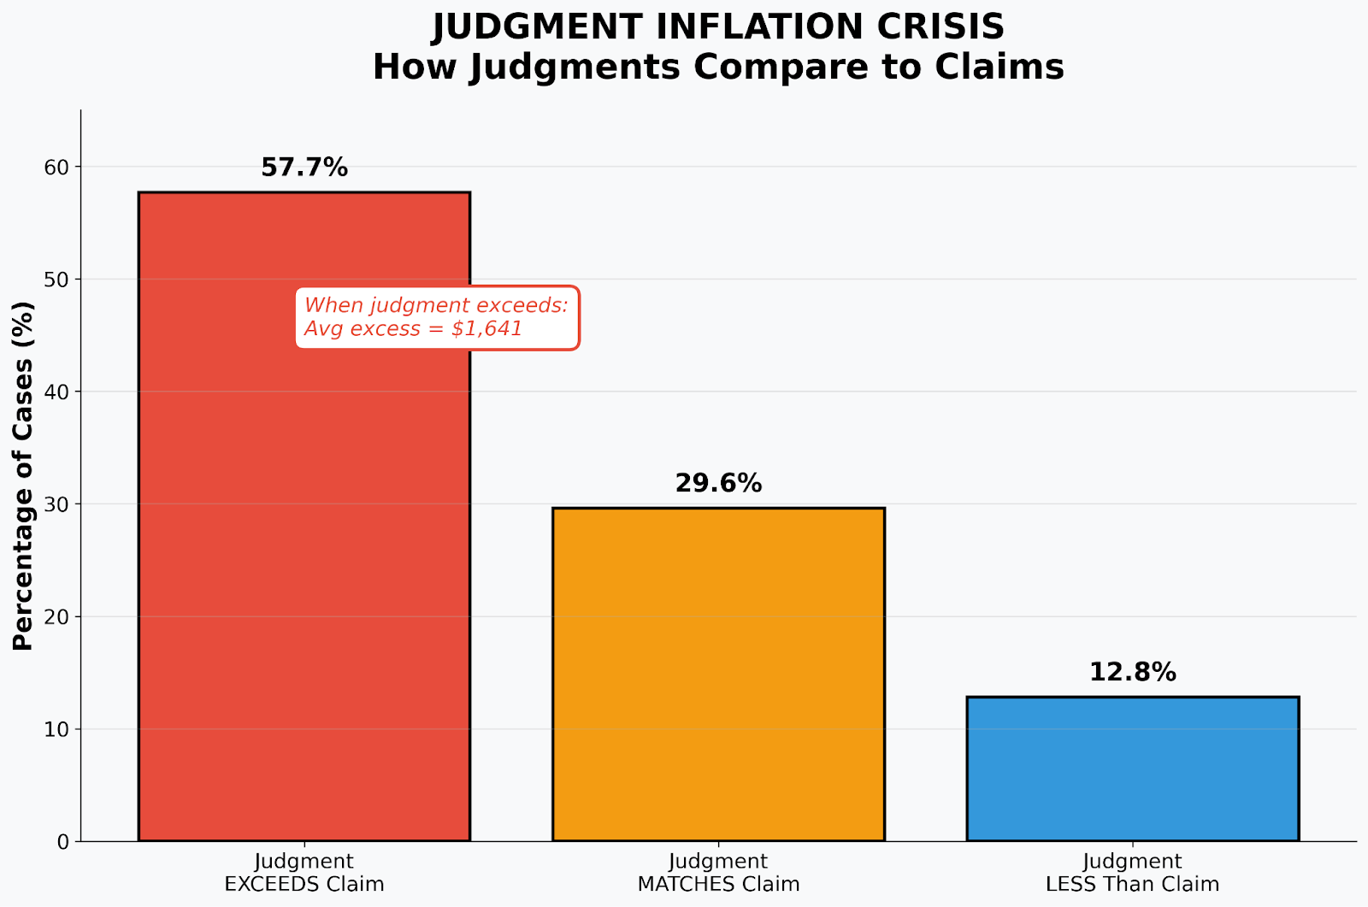
Judgement inflation crisis
Find other photo options

Slide 11
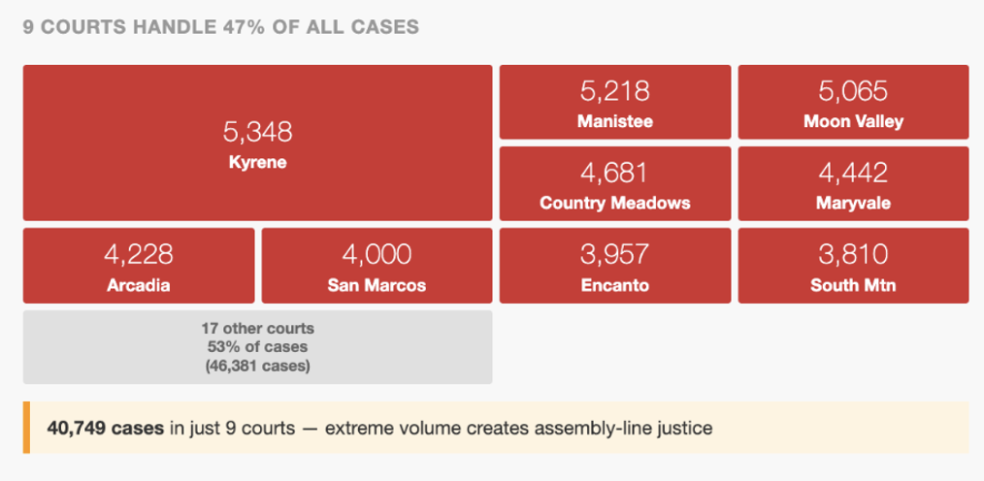
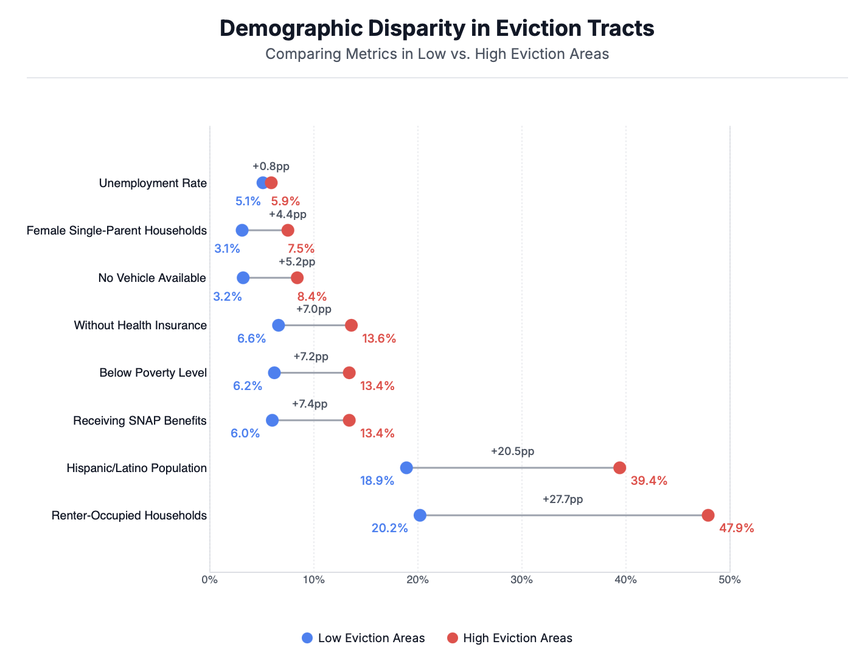
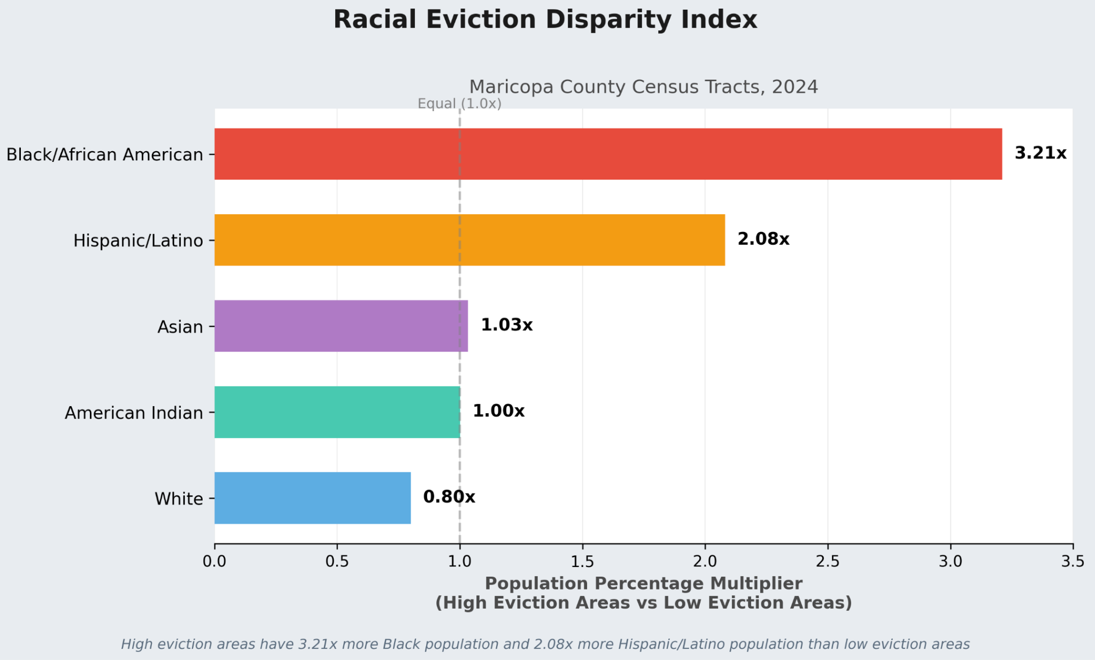
Demographics of the tenants

Slide 12
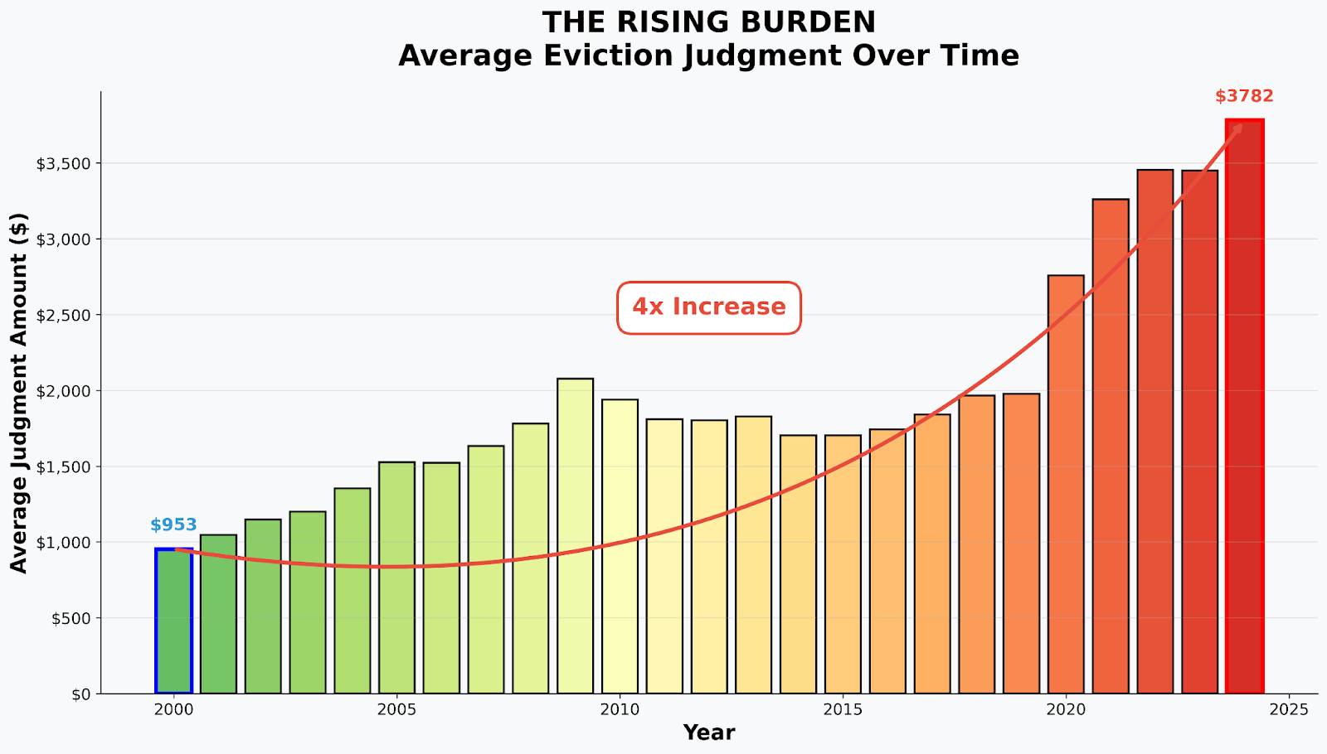
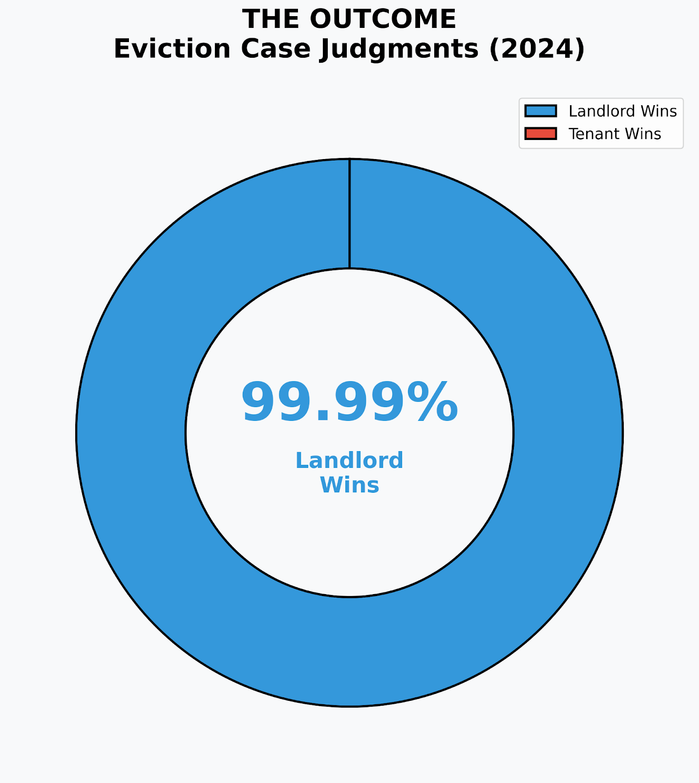
The outcome and monetary burden of eviction cases

Slide 13
Statistical Analysis track
Sean Skinner, Leticia Favero Lopes

Slide 14
Initial Factors
Dependent Variable: Eviction Rate
Independent Variables: Income and
Ethnic Demographics:
Median Income, Median Monthly Cost, Median Gross Rent
Racial Percentages
Single Male Parent, Single Female Parent, Disability, Below Poverty Line Percentages
Find other photo options

Slide 15
First Steps
Cleaned data to account for missing values
Removed outlier
One region had an eviction rate over ten times the next highest (ZIP code 85008, near Papago Park)
Generated linear regression, analyzed multicollinearity
Find other photo options
Notes:
The mentioned zip code has a high amount of renters and low median income

Slide 16
Iterative Regression
Removed ethnic demographic variables due to high levels of multicollinearity
Performed log transformations on dependent and some independent variables for goodness-of-fit
Iterated through until best fit found
Find other photo options

Slide 17
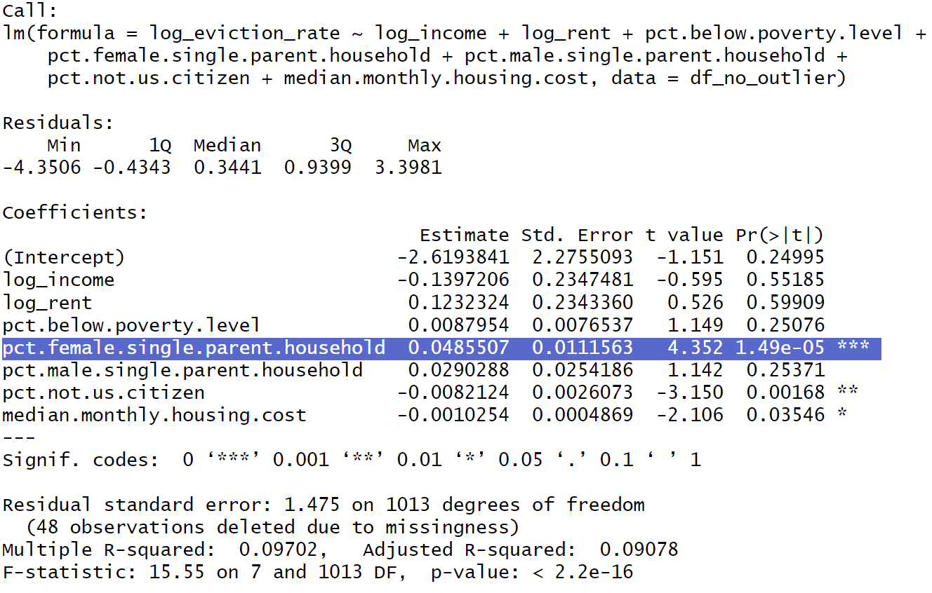
Final Regression
Most Statistically Significant Term Highlighted
Interpretation: an increase of 1 percentage point in single female parent households corresponds to an increase in the eviction rate by a factor of approximately 5%
Find other photo options

Slide 18
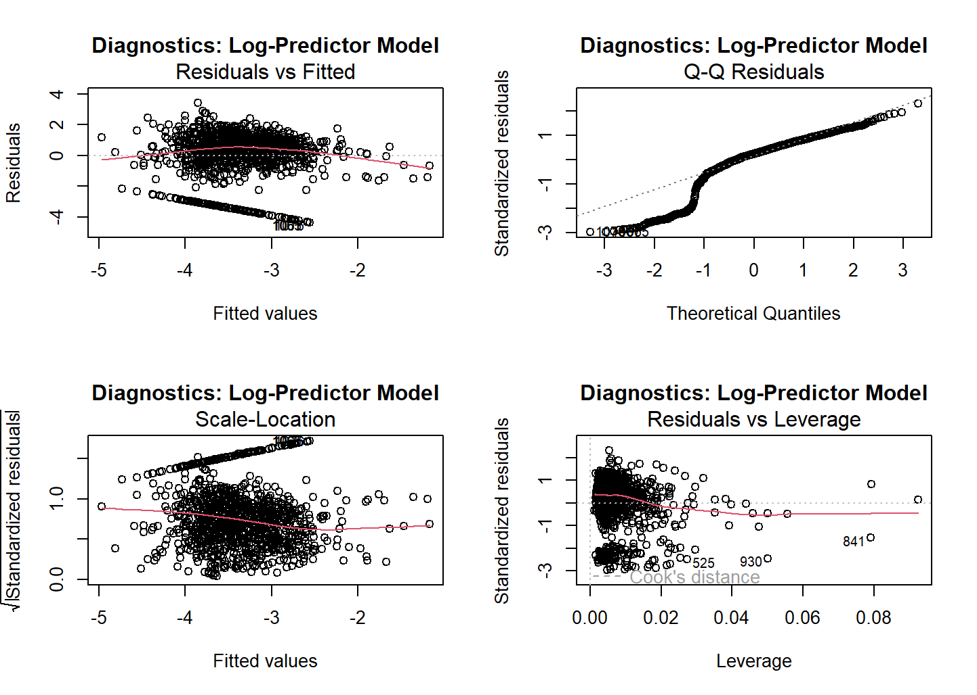
Diagnostics
Find other photo options

Slide 19
Predictive Modeling
Sai Roy, Sudamshu Rao, Harshini Balamurugan Vadivazhagi,
Rati Tabatadze, Poojitha Nuthalapati, Tylor Vongsenekeo

Slide 20
Our Prediction Strategy
The Method: Learning from the past to predict the future
The Data: Three years of Maricopa County eviction records (2022-2024)
The Goal: Forecast monthly evictions throughout 2025
The Benefit: Helps Arizona plan and budget before families are in crisis
Find other photo options

Slide 21
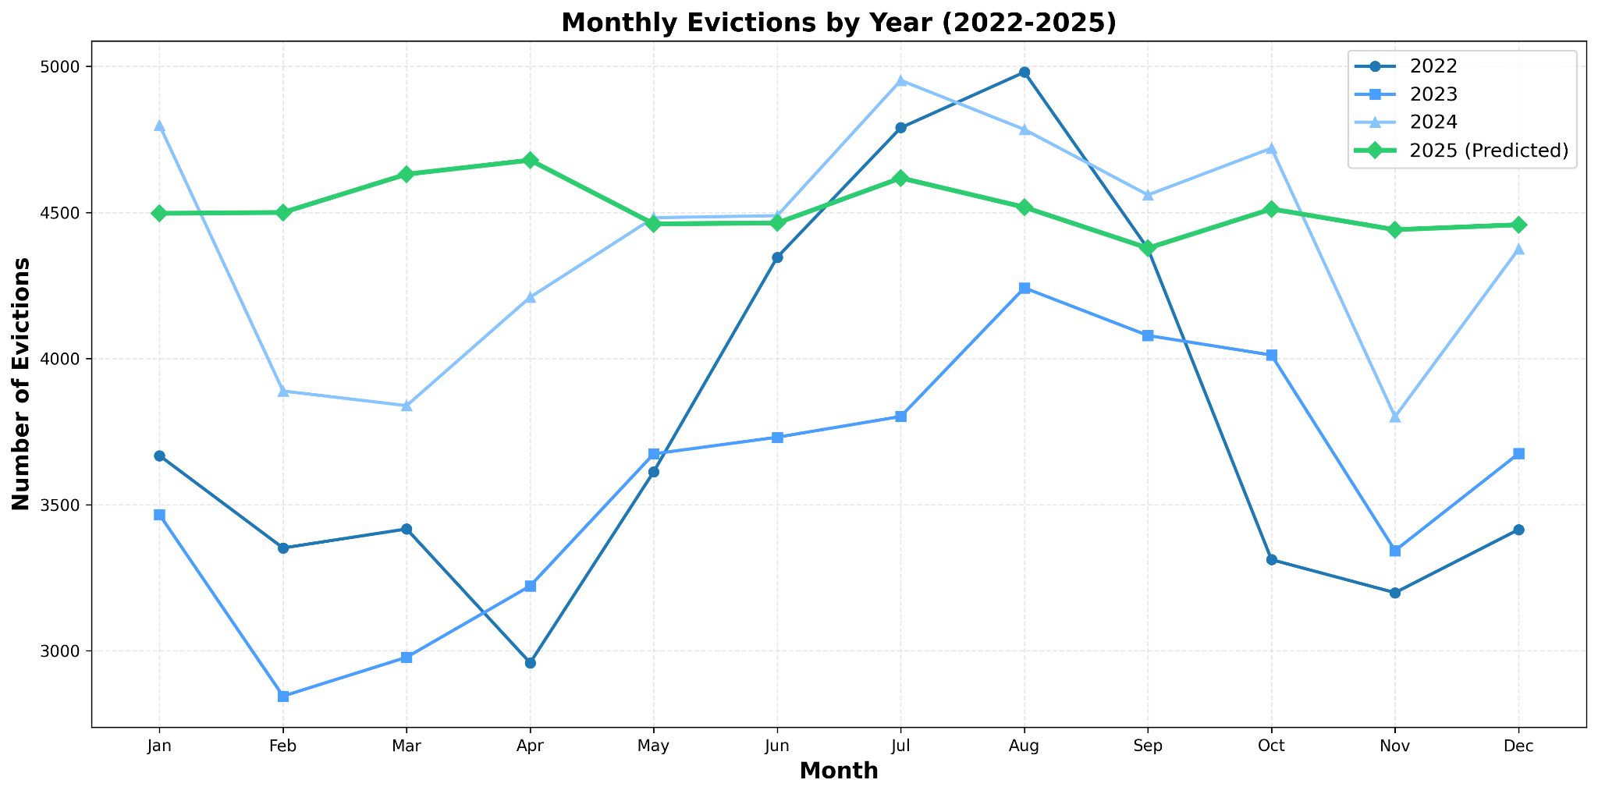
Time Series Graph
Find other photo options

Slide 22
Dataset
Using sealed records from 2022–2024 to predict eviction rates for 2025.
Year | Total Records | Average per Month
2022 | 45,428 | 3,785
2023 | 43,069 | 3,589
2024 | 52,900 | 4,408
2025 (Predicted) | 54,143 | 4,513
Find other photo options

Slide 23
What the data says
Key Takeaways:
16% increase from 2022 to 2024 - trend continues into 2025
Summer months (July-August) consistently highest risk across all years
2025 prediction: 54,143 evictions - highest year yet
Monthly average rising: From 3,785 (2022) to 4,513 (2025)
Intervention window: Spring months show early warning signs before summer peaks
Find other photo options

Slide 24
Compare with the 2025 actual evictions data
Current Statistics
Month | Evictions
January | 7,613
February | 7,070
March | 5,996
April | 6,788
May | 7,101
June | 7,029
July | 7,250
August | 7,565
September | 7,310
Prediction Results
Month | Prediction
January | 4,497
February | 4,500
March | 4,631
April | 4,679
May | 4,461
June | 4,464
July | 4,618
August | 4,518
September | 4,378

Slide 25
Moving Forward
Current Limitations:
Data Scope: Analysis limited to unsealed eviction records; sealed cases not captured in dataset
Variable Coverage: Model focuses on temporal patterns; additional socioeconomic factors could enhance accuracy
Geographic Granularity: County level analysis; census tract detail would enable targeted interventions
Future Enhancements:
Expanded Data Integration: Incorporate datasets like the labor statistics and american community survey data
Advanced Modeling: Deploy neural networks to discover complex cross dataset relationships

Slide 26
Conclusion
UDS Displaced Voices
These predictions aren't just numbers, they're real individuals needing support and each statistic represents families, children, and communities we can protect.

Slide 27


